Slide 1


Final Year Project Proposal
Self-Driving Car
Supervised By: Dr. Rizwan Bin Faiz (Assistant Professor)

Slide 2
Project Team
Bilal Rafiq (27661)
Hamza Azhar(28595)
Sardar Mohsin (28016)
M. Usama Nazir (30445)

Slide 3
Table of Content
Opportunity & Stakeholders
Existing Systems
Problem Statement
Proposed Solution
Project Scope

Slide 4
OPPORTUNITY & STAKEHOLDERS

Slide 5
Opportunity (1/3)
According to a National Highway Traffic Safety Administration (NHTSA) study, driver error led to 94% of the crashes examined.
According to the U.S. General Services Administration (GSA), human error causes 98% of crashes.
Notes:
The National Highway Traffic Safety Administration is an agency of the U.S. federal government, part of the Department of Transportation, focused on transportation safety in the United States.
GSA independent agency of the United States government established in 1949 to help manage and support the basic functioning of federal agencies.

Slide 6
Opportunity (2/3)
A 2017 study by RAND Corporation found that self-driving cars could reduce traffic fatalities by up to 25% by 2040.
A 2019 study by the National Highway Traffic Safety Administration (NHTSA) found that self-driving cars were involved in fewer crashes than human-driven cars per mile driven.
A 2020 study by the Massachusetts Institute of Technology (MIT) found that self-driving cars could prevent up to 90% of crashes caused by human error.
Notes:
RAND is a research organization that develops solutions to public policy challenges to help make communities throughout the world safer and more secure, healthier and more prosperous.

Slide 7
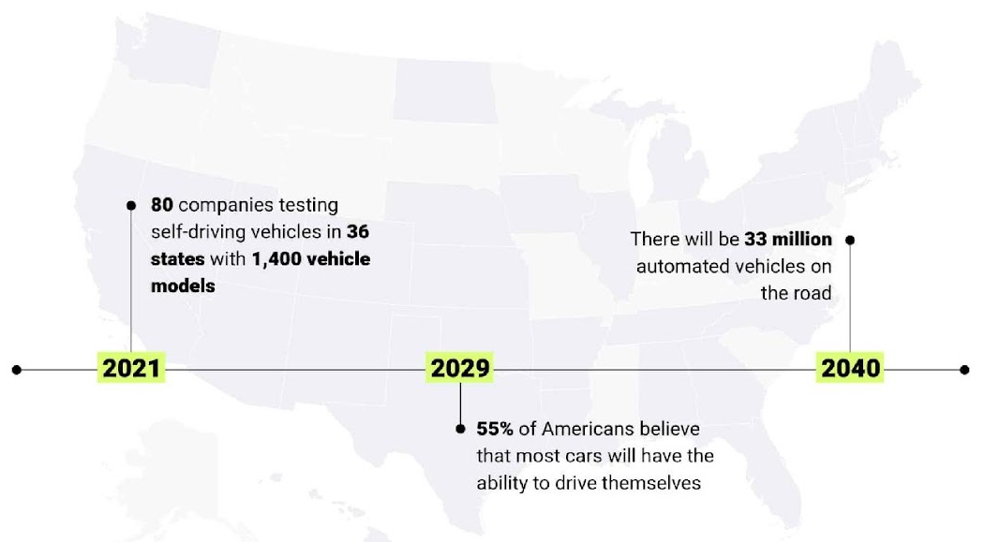
Opportunity (3/3)

Slide 8
Stakeholders
Driver
Passengers

Slide 9
EXISTING SYSTEMS

Slide 10
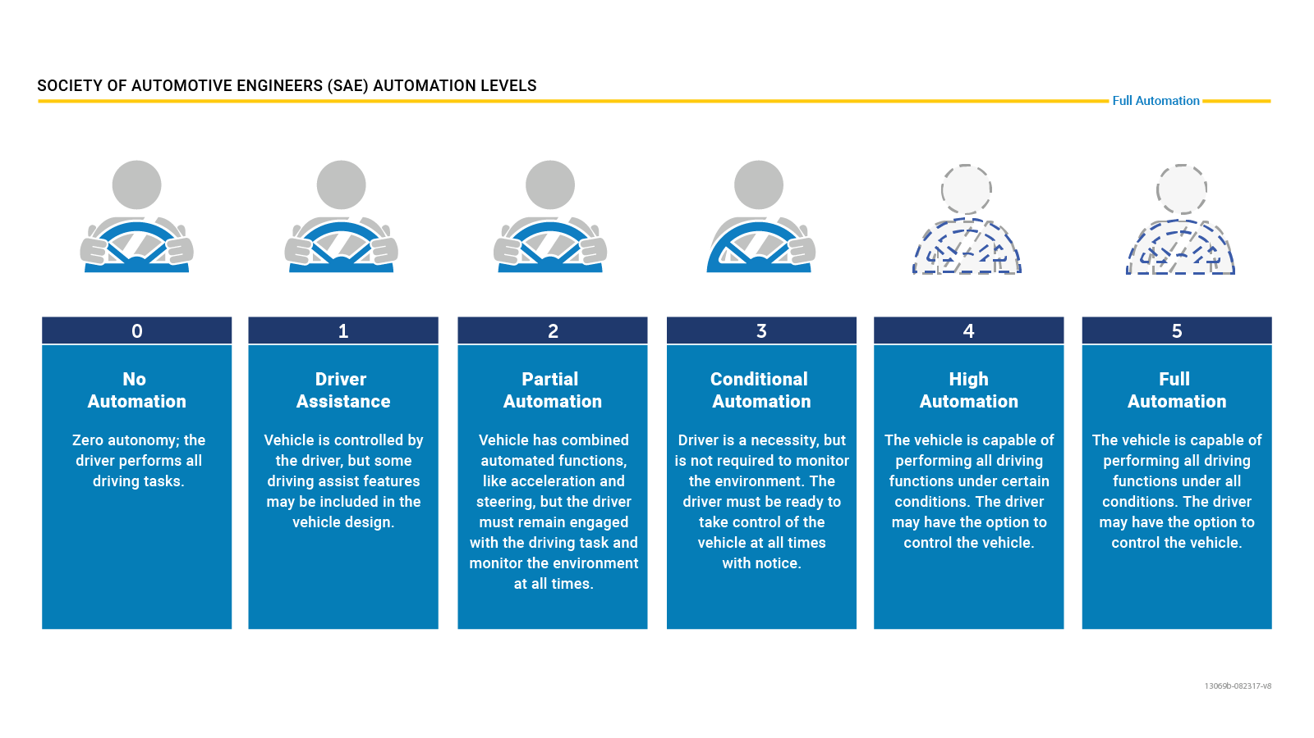
Levels of AVs
Notes:
The Society of Automotive Engineers (SAE) International has defined six levels of driving automation, ranging from Level 0 (no automation) to Level 5 (full automation). As of today, only Levels 0, 1, and 2 are commercially available in production vehicles.

Slide 11
Existing Systems (1/2)
Company | Target Level | Key Features
Tesla | Level 2 (Autopilot) | Lane keeping automatic emergency braking traffic light and stop sign recognition highway driving assist self-parking (Level 2) Navigate on Autopilot
BMW | Level 2 | Adaptive cruise control with stop-and-go lane departure warning lane change assist
Notes:
As of early 2024, no commercially available vehicles are fully autonomous, but many automakers are developing Level 4 and Level 5 vehicles.
As of March 5, 2024, commercially available vehicles primarily fall under Level 2 on the SAE International's J3016 classification system for automated driving. This signifies that they offer advanced driver assistance systems (ADAS), but not full autonomy.
While some companies, like Honda, Mercedes-Benz, BMW Group, and Kia, have received approvals for Level 3 vehicles in specific regions, these are still in limited deployment and not widely available to the public. Level 3 allows for conditional automation under certain conditions, where the driver can take their eyes off the road for brief periods.

Slide 12
Existing Systems (2/2)
Company | Target Level | Key Features
Mercedes-Benz | Level 3 (conditional) | Hands-free driving at up to 60 km/h on specific highways automatic lane changes traffic jam assist emergency stop assist
Way-mo | Level 4 | LiDAR-based system for navigating complex extensive real-world testing millions of miles driven
Cruise | Level 5 | Fully autonomous robo-taxi no steering wheel or pedals LiDAR, radar, and camera sensors designed for urban operation
Notes:
Tesla, BMW: Path Planning and following:
employ a variety of path planning algorithms, including:
Graph search:
Probabilistic roadmaps (PRMs)
Learning-based methods
Model predictive control
Obstacle Detection and Avoidance:
not publicly known (DEEP MACHINE LEARNING)
Mercedes (no disclosed)
Waymo and cruise doesn't disclose the specific algorithms they use but use High-definition (HD) maps: These detailed maps provide information about the environment, including lane markings, traffic signals, and points of interest. The system can leverage these maps for path planning within the designated areas.

Slide 13
PROBLEM STATEMENT
Notes:
Interviewing and questionnaires
Requirements workshops
Prototyping
Brainstorming
Observation

Slide 14
Problem Statement (1/3)
Problem Statement # 1: Hazards caused by human errors
The problem of | ensuring road safety encompasses the hazards caused by human errors, lead to accidents and endanger both drivers and pedestrians alike
Affects | Passengers, drivers, and pedestrians.
The result of which | More injuries/deaths, Damage to property and Emotional stress
Benefits of | Reduced accidents and fatalities Mitigation of human errors Safer environment for drivers and pedestrians
Notes:
According to a National Highway Traffic Safety Administration (NHTSA) study, driver error led to 94% of the crashes examined.
According to the U.S. General Services Administration (GSA), human error causes 98% of crashes.

Slide 15
Problem Statement (2/3)
Problem Statement # 2: Limited driver productivity
The problem of | no productivity from the driver when driving. Attending a meeting or doing office work while driving also not allowed.
Affects | Drivers
The result of which | It decreased efficiency
Benefits of | Increased productivity

Slide 16
Problem Statement (3/3)
Problem Statement # 3: Poor mobility for the aged, disabled, and children.
The problem of | transportation reliance for vulnerable groups such as children, the elderly, and the disabled manifests when drivers are absent
Affects | Passenger.
The result of which | increased risks to the health vulnerable individuals, potentially leading to delayed or insufficient medical care in emergency situations
Benefits of | Enhanced accessibility, Enhanced independence and Reduced burden on caregivers
Notes:
ultimately compromising their well-being and quality of life.

Slide 17
PROPOSED SOLUTION

Slide 18
PROPOSED SOLUTION
We propose a Self Driven Car, featuring optimized path planning, obstacle detection, dynamic avoidance for reliable and adaptable behavior in simulated environments.
Notes:
Optimized path planning: Refers to the efficient calculation of the vehicle's route considering factors such as shortest distance, time efficiency, and avoiding obstacles to reach the destination swiftly.
Dynamic avoidance: Involves real-time adjustments to the vehicle's trajectory to navigate around unexpected obstacles or changes in the environment, ensuring adaptability and responsiveness to dynamic scenarios.

Slide 19
PROJECT SCOPE
Notes:
Project Scope is function of
The functionality that must be delivered
The resources available
The time available

Slide 20
Project Scope (1/6)
Scope:
The scope of this project encompasses the development and implementation of key functionalities for Avs using:
Carla simulator, ROS (Robot Operating System) Noetic, and related packages such as rospy and Carla-ros-bridge.
Involve integrating various sensors and algorithms to enable the vehicle to perceive its environment accurately, make decisions, and navigate safely through dynamic scenarios.
Notes:
"The primary problem we're addressing is enabling autonomous vehicles to navigate from a source to a destination efficiently and safely.“
To tackle these challenges, we're leveraging a combination of technologies, including the CARLA simulator for realistic vehicle simulation, ROS Noetic for robotic system development, the CARLA-ROS bridge for seamless integration between CARLA and ROS, and rospy for Python-based ROS programming.

Slide 21
Core Components (2/6)
Path Planning:
Determining a feasible and shortest path from user-specified source and destination locations
Implementing a navigation algorithm to handle dynamic environments and potential rerouting.
Path Following:
Implementing control algorithms for precise vehicle guidance along the planned trajectory.
Maintaining vehicle position and orientation relative to the path using steering, acceleration, and braking control.
Notes:
"Our project aims to address the challenge of enabling autonomous vehicles to navigate safely and efficiently from a source to a destination. We're focusing on several key components essential for autonomous navigation, including path following, path planning, obstacle detection and avoidance.
Our overarching objective is to develop a robust software solution that empowers autonomous vehicles to navigate complex environments with precision and safety."

Slide 22
Core Components (3/6)
3. Obstacle Detection:
Utilizing sensor data (such as lidar, radar, and cameras) to detect objects within the vehicle's surroundings.
Employing model to classify detected objects and assess their characteristics, such as size, shape, and distance.
Integrating machine learning techniques to improve the accuracy and reliability of obstacle recognition.
Providing real-time information about detected obstacles to inform path planning and navigation decisions.

Slide 23
Core Components (4/6)
4. Obstacle avoidance:
Implement reactive obstacle avoidance strategies, allowing the autonomous vehicle to dynamically adjust its trajectory based on the detected obstacles, enabling safe navigation.
Develop algorithms for real-time analysis of obstacle data to facilitate swift decision-making by the autonomous vehicle.

Slide 24
Secondary task (4/6)
Traffic light detection and management:
Detecting the presence and state (red, green, yellow) of traffic lights using appropriate sensors and algorithms.
Implementing logic to respond to traffic lights (stopping, proceeding cautiously, etc.) in accordance with traffic regulations.
Notes:
Prioritizing tasks is crucial for effective project management
Secondary tasks, such as traffic light detection and management, will be addressed once primary tasks are completed.

Slide 25
Project Scope (5/6)
Exclusions:
Physical implementation on real-world vehicles.
Hardware development or modifications beyond the scope of software integration.
Advanced features such as pedestrian detection and recognition.
Constraints:
Limited computational resources available for simulation and testing.
Risks associated with software bugs, simulation inaccuracies, and algorithm performance.

Slide 26
Project Scope (6/6)
Assumptions:
Assumption that Carla simulator and ROS Noetic will remain stable and compatible throughout the project timeline.
Availability of necessary resources for simulation and testing purposes.
Assumption that team members have sufficient expertise in ROS, Python programming, and autonomous systems development.

